Slide 1
Bioprinting techniques and materials
Biology for Engineers
21BE45
Prepared by,
Dr. Akshatha Prasanna
Assistant Professor
Department of Biotechnology
Dayanandasagar college of engineering

Slide 2
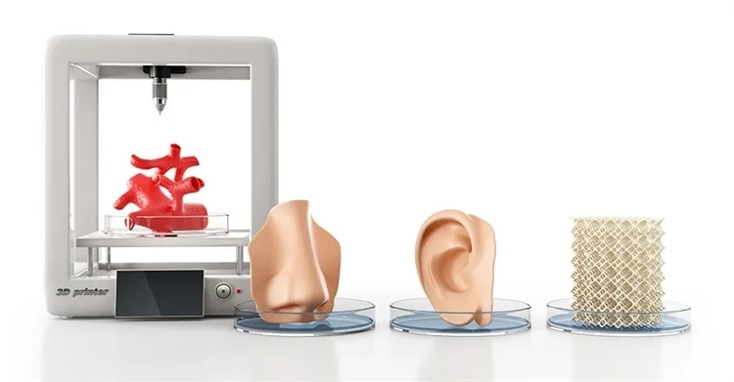
Bioprinting
Bioprinting is a rapidly evolving field that combines biology and 3D printing technology to create functional living tissues and organs.
The 3-D printing manufacturing process creates a solid, three-dimensional object from a digital model. The technology generally involves a computer-controlled printer depositing material in thin layers to create the precise shape of the object.
Notes:
Bioprinters work similarly to traditional 3-D printers; however, instead of depositing layers of plastic, they deliver layers of biomaterial which includes living cells. These living cells are grown from seed cells taken from the patient and cultivated to form a bioink. The printers follow instructions from detailed computer models of organs or other tissues that are often made specifically for a given patient. Thus, through the use of an MRI scan and harvested cells, printers can make a custom organ, providing a perfect match.

Slide 3







Bioprinting Techniques
There are several different bioprinting techniques that have been developed to create 3D structures with living cells. These techniques can be broadly categorized into three main types:
Extrusion-based bioprinting: In this technique, a bioink containing living cells is extruded through a nozzle to create layers that eventually form a 3D structure. The bioink may contain cells, hydrogels, and other biomaterials that provide structural support.
Inkjet-based bioprinting: Similar to traditional inkjet printing, this technique uses a print head to deposit droplets of bioink containing cells onto a substrate. These droplets can be precisely controlled to create patterns or layers of cells.
Laser-assisted bioprinting: In this technique, a laser is used to generate a pressure wave that propels small droplets of bioink onto a substrate to create a 3D structure. This technique allows for high precision and control over the deposition of cells.

Slide 4
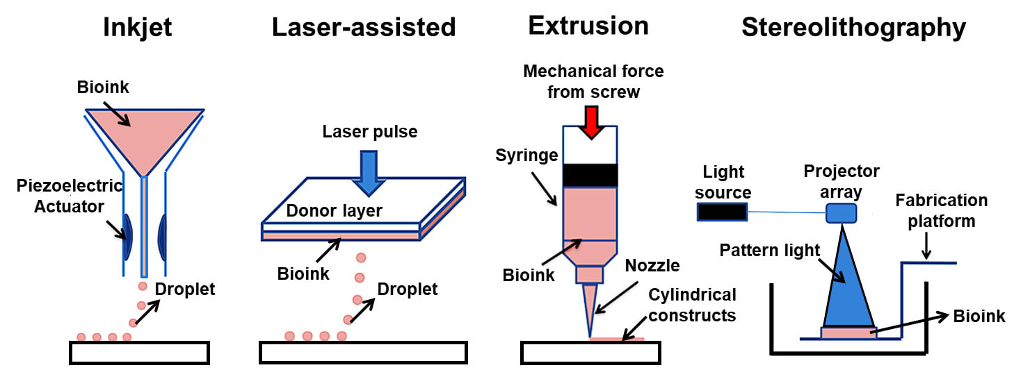
Notes:
https://facellitate.com/what-are-the-types-of-3d-bioprinting-technologies/

Slide 5
3D Bioprinting Workflow
Preprocessing
Imaging
3D Modeling
Processing
Bioink Preparation
Bioprinting
Post Processing
Cell culture and differentiation
Application

Slide 6




Applications of Bioprinting
Bioprinting has the potential to revolutionize several areas of healthcare, including:
Tissue engineering: Bioprinting can be used to create functional tissues and organs that can be transplanted into patients with damaged or diseased tissues. This has the potential to address the shortage of organs for transplantation and reduce the need for immunosuppressive drugs.
Drug discovery and screening: Bioprinted tissues can be used for drug testing to predict human response more accurately and reduce the reliance on animal testing. This can accelerate the drug discovery process and make it more efficient.
Disease modeling: Bioprinting can be used to create disease models that closely mimic human tissues, allowing researchers to study disease mechanisms and develop personalized treatment approaches.

Slide 7
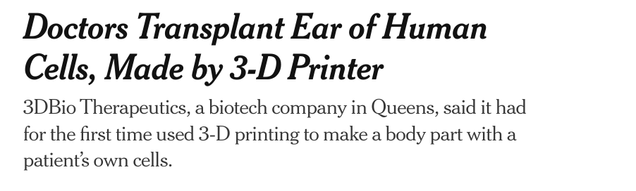
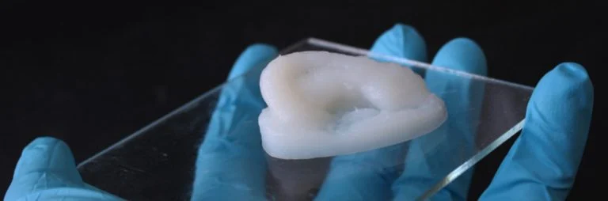
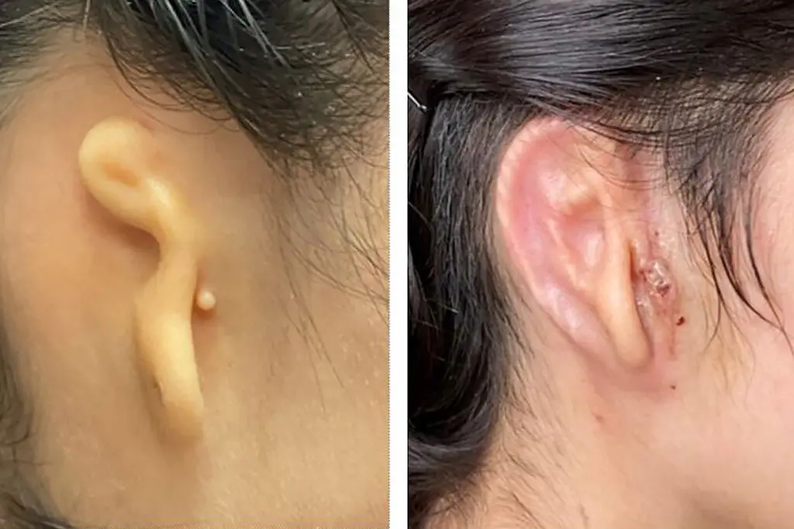
3D Printing of Ear : Tissue engineering

Slide 8



A 20-year-old woman, from Mexico, was born with microtia, a rare birth defect that causes the auricle, or external part of the ear, to be small and malformed (it also can affect hearing in the ear).
She has received a 3-D printed ear implant made from her own cells.
This is the first time that 3D-printed tissue had been implanted into a human body.
To print an ear, 3DBio Therapeutics scientists first built a three-dimensional computer model, based on a scan of the woman’s other ear.
Then, they cultured living cells and put them into a “bioink” made of collagen ( type of protein in skin and bone)
A printer then deposited the bioink layer after layer to create the right shape — a mirror image of the woman’s ear.
A final biodegradable shell shields the implant while it generates cartilage

Slide 9
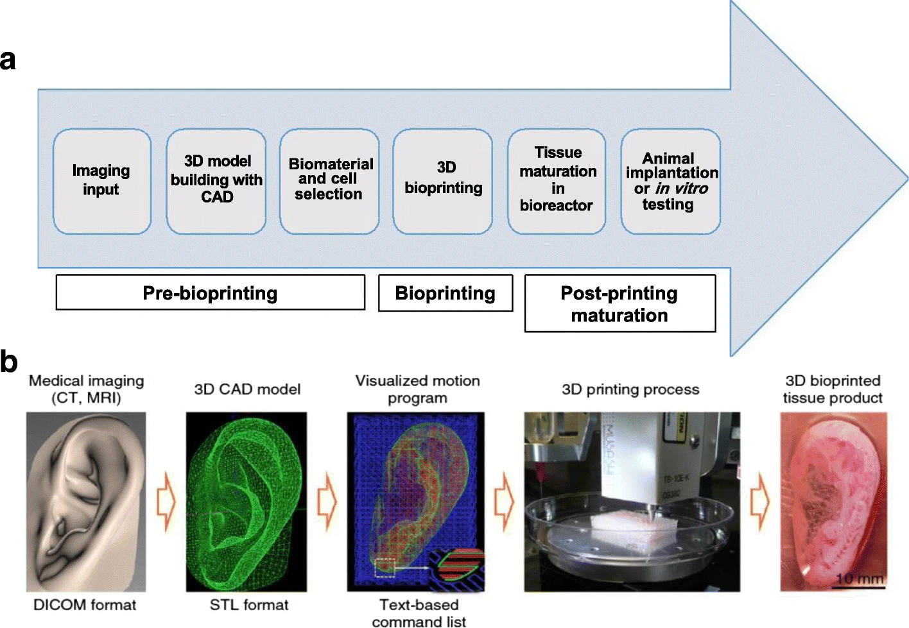

Slide 10
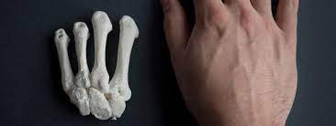
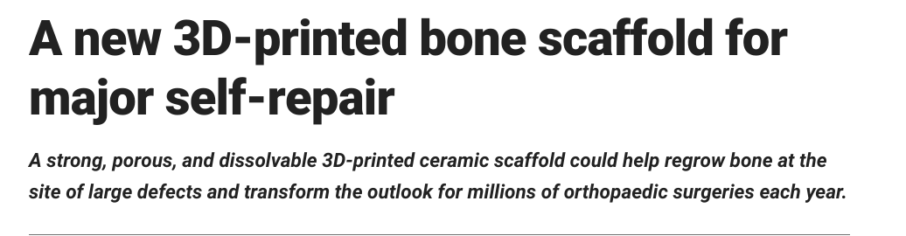
3D printing of bone

Slide 11
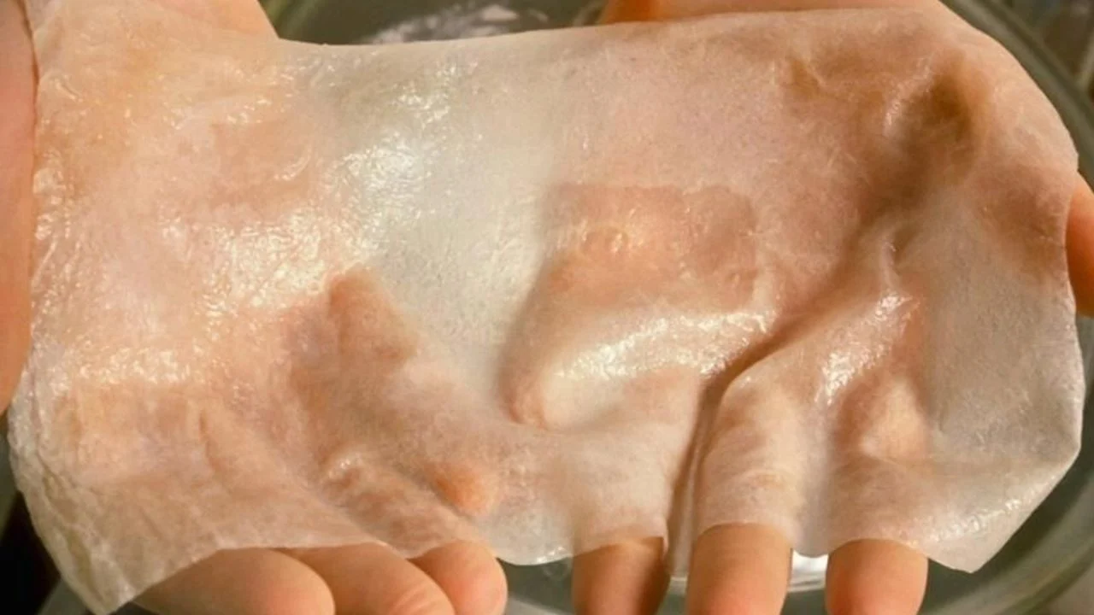
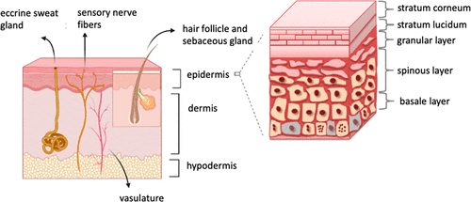






3D printing of skin
Bioink : Collagen, Gelatin, Chitosan, Fibrin
Cell Lines:
Fibroblast : Dermal formation : Wound healing
Mimic Natural Skin : Melanocytes
Keratinocytes
Hair follicles
Applications
Treatment of Burn Injuries and Wound Healing
Modeling of Skin Diseases (analyze the mode of action in cancer proliferation and metastasis and reaction to the selected drug)
The Cosmetic and Pharmaceutical Industry
Notes:
https://pubs.acs.org/doi/10.1021/acssynbio.1c00547

Slide 12

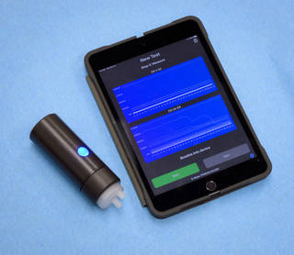
Biology for Engineers
Trends in Bioengineering (Module-4)
Electrical nose in food science
Electronic Noses and Tongues in Food Science describes the electronic products of advanced chemical and physical sciences combined with intuitive integration of microprocessors, advanced
bioinformatics and statistics.
The smells are composed of molecules, which has a specific size and shape.
Each of these molecules has a corresponding sized and shaped receptor in the human nose.
When a specific receptor receives a molecule it sends a signal to the brain and brain identifies the smell associated with the particular molecule.
The electronic noses work in a similar manner of human.
The electronic nose uses sensors as the receptor. When a specific sensor receives the molecules, it transmits the signal to a program for processing, rather than to the brain.
NASA’s E-Nose, or electronic nose, device for COVID-19 detection

Slide 13
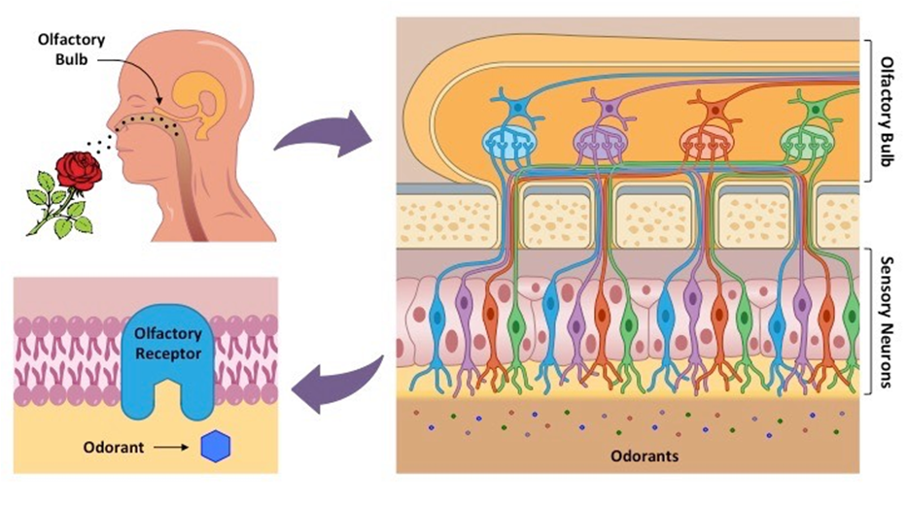
Biology for Engineers
Trends in Bioengineering (Module-4)
Electrical nose in food science

Slide 14
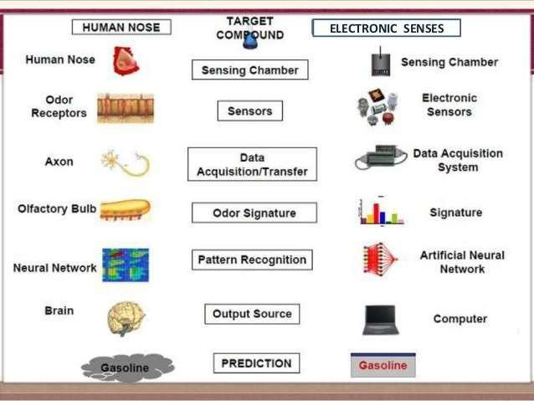
Biology for Engineers
Trends in Bioengineering (Module-4)
Electrical nose in food science

Slide 15
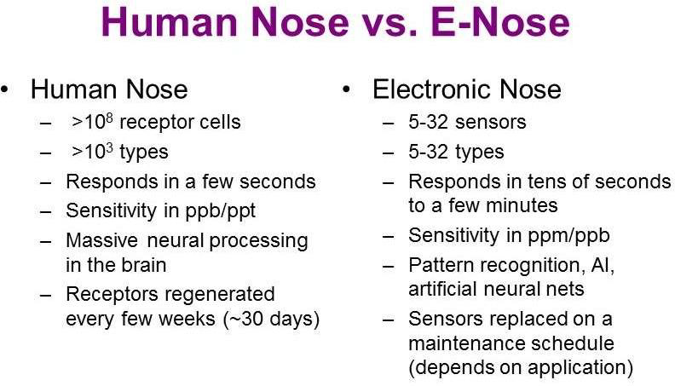
Biology for Engineers
Trends in Bioengineering (Module-4)
Electrical nose in food science

Slide 16
Biology for Engineers
Trends in Bioengineering (Module-4)
Electrical nose in food science - Applications
Inspection food, beverage quality by odour
Inspection of meat, fish, egg, diary products
Monitoring the fermentation
Automated flavour control
Characterising coffee beans,chocolate etc
Analysis of fruit ripening

Slide 17
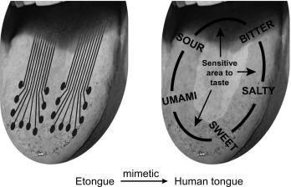
Biology for Engineers
Trends in Bioengineering (Module-4)
Electrical tongue
“Electronic tongue” (e-tongue) is instrumental system are designed to crudely mimic human taste sensory organs and are composed of an array of sensors.
e-tongue are defined as an array of non-specific chemical sensors with partial sensitivity to different components, able to analyze complex liquids.
e- tongues are normally used to give qualitative answers about the sample studied and only in some cases to predict the concentration of individual species in the sample.

Slide 18
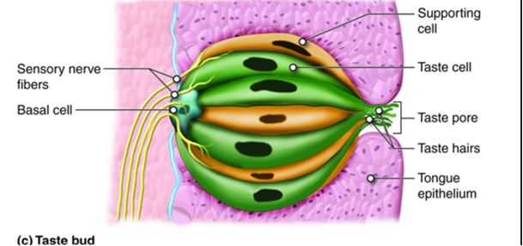
Biology for Engineers
Trends in Bioengineering (Module-4)
Electrical tongue

Slide 19
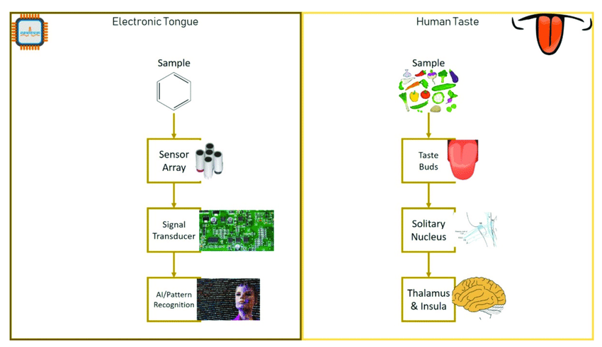
Biology for Engineers
Trends in Bioengineering (Module-4)
Electrical tongue

Slide 20




Biology for Engineers
Trends in Bioengineering (Module-4)
Electrical tongue - Applications
Analyze flavor aging in beverages (for instance fruit juice, alcoholic or non alcoholic drinks, flavored milk...)
Quantify bitterness or “spicy level” of drinks or dissolved compounds (e.g. bitterness measurement and prediction of teas)
Quantify taste masking efficiency of formulations (tablets, syrups, powders,
capsules, lozenges...)
Analyze medicines stability in terms of taste
Benchmark target products
Monitor environmental parameters of the products.
Monitor biological and biochemical processes

